Slide 1
Digital Logic I. Basics
Jalal Kawash

Slide 2
Outline
Digital Logic I
Basics
Introduction
Binary Logic
Logic Gates
Boolean Functions & Logic Circuits
Logic Circuits
Minterms and Gate-Level Minimization
Minterms
Boolean Sum of Products
K-Maps

Slide 3
Introduction
Digital Logic I
Basics
Section 1

Slide 4
Section 1 Objectives At the end of this section you will
Digital Logic I
Basics
Recall binary logic and logic operators
Recall the definition of AND, OR, NOT, and XOR
See the correspondence between gates and logic operators
Build Boolean functions
Build digital logic circuits that correspond to Boolean functions

Slide 5
Binary Logic
Deals with:
Binary variables
Take values from {0, 1}
Logic operators
Three basic operators: AND, OR, and NOT

Slide 6
Logic Operators: AND
x AND y
Switch x
Switch y
Output

Slide 7
Logic Operators: AND
Let x and y be binary variables, x.y or xy is defined by:
x | y | xy
0 | 0 | 0
0 | 1 | 0
1 | 0 | 0
1 | 1 | 1

Slide 8
Logic Operators: OR
x OR y
Switch x
Output
Switch y

Slide 9
Logic Operators: OR
Let x and y be binary variables, x+y is defined by:
x | y | x+y
0 | 0 | 0
0 | 1 | 1
1 | 0 | 1
1 | 1 | 1

Slide 10
Logic Operators: NOT
Let x be binary variables, x’ is defined by:
x | x’
0 | 1
1 | 0

Slide 11
Precedence
Logic operators are applied in the following order:
Parentheses
NOT
AND
OR
Exercise: Create truth tables for x+xy’ and x+(xy)’

Slide 12
Useful Logic Laws
x+0 = x | x.1 = x
x+x’ = 1 | x.x’ = 0
x+x = x | x.x = x
x+1 = 1 | x.0 = 0
(x’)’ = x
x+y = y+x | x.y = y.x
x + (y+z) = (x+y) + z | x(y.z) = (x.y)z
x(y + z) = x.y + x.z | x + y.z = (x+y)(x+z)
(x+y)’ = x’.y’ | (xy)’ = x’ + y’
x + xy = x | x(x+y) = x

Slide 13
Useful Logic laws
Exercise: Verify these laws using truth tables

Slide 14
Logic Gates
A logic gate is an electronic circuit that operates on one or more input signals to produce one output signal
Signals represent 0s and 1s
Typically 0-1V for 0 and 2-3V for 1
Logic gates are basic building blocks for digital machines
There is a gate for each logic operator

Slide 15
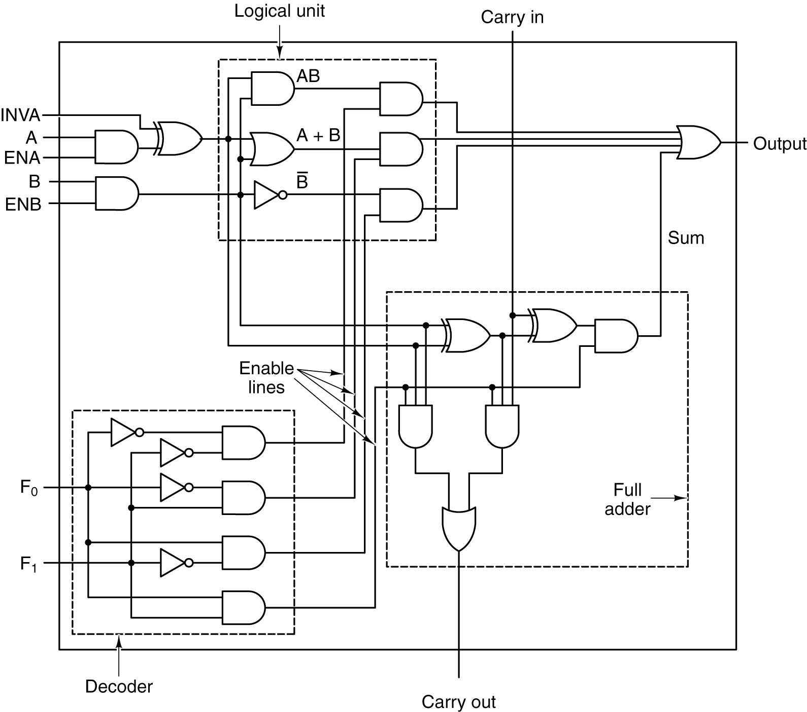
AND gate
x | y | xy
0 | 0 | 0
0 | 1 | 0
1 | 0 | 0
1 | 1 | 1
Think of it as a function :
bit and( bit x, bit y)
x
xy
y

Slide 16
OR gate
x | y | x+y
0 | 0 | 0
0 | 1 | 1
1 | 0 | 1
1 | 1 | 1
Think of it as a function :
bit or( bit x, bit y)
x
x+y
y

Slide 17
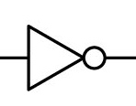
NOT gate (invertor)
x | x’
0 | 1
1 | 0
Think of it as a function :
bit not( bit x)
x
x’

Slide 18
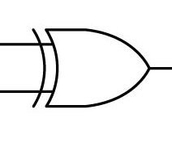
More Gates: Exclusive OR (XOR)
x | y | x⊕y
0 | 0 | 0
0 | 1 | 1
1 | 0 | 1
1 | 1 | 0
x
x ⊕ y
y

Slide 19
XOR is redundant
x⊕y = x’y + y’x
x⊕y = (x+y)(xy)’
Exercise: Verify these laws using truth tables

Slide 20
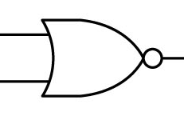
More Gates: NOT OR (NOR)
x | y | x+y | (x+y)’
0 | 0 | 0 | 1
0 | 1 | 1 | 0
1 | 0 | 1 | 0
1 | 1 | 1 | 0
x
(x+y)’
y

Slide 21
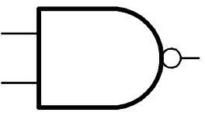
More Gates: NOT AND (NAND)
x | y | xy | (xy)’
0 | 0 | 0 | 1
0 | 1 | 0 | 1
1 | 0 | 0 | 1
1 | 1 | 1 | 0
x
(xy)’
y

Slide 22

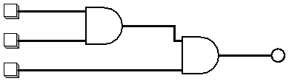
Gates with more inputs
It is possible to feed a gate (except invertors) more than 2 inputs
Note that this is equivalent to

Slide 23
Boolean Functions
A Boolean function combines binary variables using logic operators.
Examples:
F1 = x + y’z
F2 = x’y’z + x’yz +xy’
Exercise: Simplify to get x’z + xy’

Slide 24
Boolean Function Exercises
Simplify:
xyz’ +x’yz+xyz+x’yz’
Answer: y
(x+y’+z’)(x’+z’)
Answer: z’ +x’y’
yz(xz+x’+xz’)
Answer: yz

Slide 25
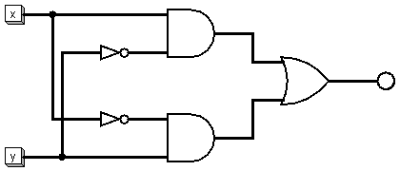
Logic Circuits
A logic circuit is formed of logic gates and calculates a Boolean function
Example: x’y +y’x
Source: DL1.circ (xor1)

Slide 26
Logisim
Free simulator for logic circuits
Downloadable from various places
http://sourceforge.net/projects/circuit/
Demo!
XOR1 & XOR2

Slide 27
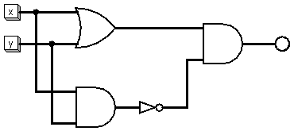
Another XOR Circuit
Source: DL1.circ (xor2)
x⊕y = (x+y)(xy)’

Slide 28
Boolean Function Exercises
Draw the corresponding logic circuit:
xyz’ +x’yz+xyz+x’yz’
Answer: y
(x+y’+z’)(x’+z’)
Answer: z’ +x’y’
yz(xz+x’+xz’)
Answer: yz

Slide 29
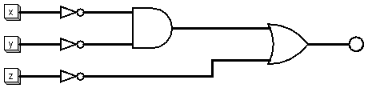
F = z’ +x’y’
x’
x’y’
y’
F = z’ +x’y’
z’
Source: DL1.circ (Example1 Function)

Slide 30
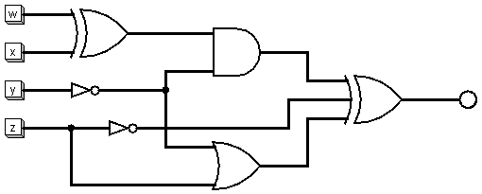
Boolean Function Exercise
What is the Boolean function corresponding to the following circuit?
Source: DL1.circ

Slide 31
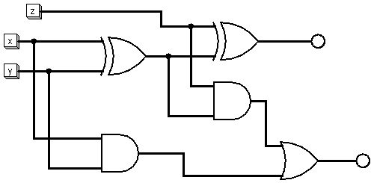
Self-Test Quiz
What is the Boolean functions corresponding to the following circuit?
F1
F2

Slide 32
Minerms and Gate-Level Minimization
Digital Logic I
Basics
Section 2

Slide 33
Section 2 Objectives At the end of this section you will
Digital Logic I
Basics
Master the Boolean-Sum-of-Products algorithm
Convert truth tables to Boolean functions
Minimize minterms in a function using factorization
Minimize minterms in a function in canonical form using K-Maps

Slide 34
Boolean Sum of Products (BSP)
Truth table = Boolean function(s) = Logic Circuit
BSP Algorithm:
Given a truth table, convert each column C to an equivalent function F_{C} as follows:
For each output column, for each row R where the output is 1:
f_{R} = empty
For each input value x in R that is 1, f_{R} = f_{R}.x
For each input value x in R that is 0, f_{R} = f_{R}.x’
F_{C} = ∑_{R} f_{R}

Slide 35
BSP Example
x | y | x⊕y
0 | 0 | 0
0 | 1 | 1
1 | 0 | 1
1 | 1 | 0
x’y
xy’
F = x’y + xy’ = x⊕ y

Slide 36
BSP Example
x | y | z | F1 | F2
0 | 0 | 0 | 0 | 0
0 | 0 | 1 | 1 | 0
0 | 1 | 0 | 1 | 0
0 | 1 | 1 | 0 | 1
1 | 0 | 0 | 1 | 0
1 | 0 | 1 | 0 | 1
1 | 1 | 0 | 0 | 1
1 | 1 | 1 | 1 | 1
Convert the following table to 2 functions F1 and F2
What do F1 and F2 represent?

Slide 37
Minterms
Minterm symbol | Minterm | Corrsponding binary number
m_{o} | x’y’z’ | 000
m₁ | x’y’z | 001
m₂ | x’yz’ | 010
m₃ | x’yz | 011
m₄ | xy’z’ | 100
m₅ | xy’z | 101
m₆ | xyz’ | 110
m₇ | xyz | 111
BSP is often called sum of minterms
Example: minterms with three variables

Slide 38
Understanding minterms
m_{i} corresponds to the binary number i
(Assume a 3-variable function)
If i = 1, i in binary is 001
m₁ is x’y’z
That is, if the digit is 0, negate the corresponding variable (x’ and y’)
If the digit is 1, leave the corresponding variable as is (z)

Slide 39
Minterms Canonical Form
A function is in canonical form if it is a sum of minterms
Examples:
F1(x, y, z) = x’yz’ + x’yz + xy’z
F1(x, y, z) = m₂ + m₃ + m₅
F1(x, y, z) = ∑ (2, 3, 5)
F2(x, y, z) = x’y’z’ + x’y’z + x’yz’ + x’yz
F2(x, y, z) = m₀ + m₁ + m₂ + m₃
F2(x, y, z) = ∑ (0, 1, 2, 3)

Slide 40
Karnaugh-Maps
A K-map is a visual representation of a Boolean function in canonical form
It helps in the process of simplifying a function
An n-variable function in canonical form will have up to 2^{n} minterms
The form in which the variable appear in a term (such as x or x’) is called a literal
In an n-variable function, each minterm consists of n literals (e.g. x’yz’ in a 3-variable function)

Slide 41
2-Variable Functions
Minterms:
2-variable map:
m_{o} | x’y’ | 00
m₁ | x’y | 01
m₂ | xy’ | 10
m₃ | xy | 11
m₀
m₁
m₂
m₃

Slide 42
2-Variable Maps
F1 = x’y’ + x’y + xy is
m₀
m₁
m₂
m₃
F2 = x’y’ + xy’ is
m₀
m₁
m₂
m₃

Slide 43
Adjacency
m₀
m₁
m₂
m₃
Two squares in a map are said to be adjacent if the corresponding minterms differ in one literal only.
Example m₀ and m₁ are adjacent
m₀ = x’y’ and m₁ is x’y
Differ in y
Similarly, m₀ and m₂ are adjacent
m₂ and m₃
m₁ and m₃

Slide 44
Simplifying Functions
Two adjacent squares can be combined to eliminate the different literal
Example: x’y + xy = y(x+x’) = y(1) = y
A map gives us clues as to which minterms should be combined

Slide 45
Example
m₀
m₁
F (x, y) = ∑ (1, 2, 3)
Combine 1 and 3
Combine 2 and 3
F = x’y + xy’ + xy
F = x’y + xy + xy’ + xy (since xy + xy = xy)
F = y(x’+x) + x (y’+y)
F = y + x
m₂
m₃

Slide 46
2-Variable Map Observations
The number of adjacent squares that can be combined is a power of 2
A single square represents a minterm with 2 literals (e.g. x’y)
2 adjacent squares represent one minterm with 1 literal (e.g. x)
4 adjacent squares represent the function F = 1

Slide 47
3-Variable Functions
m_{o} | x’y’z’
m₁ | x’y’z
m₂ | x’yz’
m₃ | x’yz
m₄ | xy’z’
m₅ | xy’z
m₆ | xyz’
m₇ | xyz
m₀
m₁
m₃
m₂
m₄
m₅
m₇
m₆

Slide 48
Adjacency
Same definition
Adjacent too
m₀
m₁
m₃
m₂
m₄
m₅
m₇
m₆

Slide 49
Adjacency
0 and 2 are adjacent
000 and 010: they differ in one bit
The corresponding minterms x’y’z’ and x’yz’ only differ in y
Note that 1 and 2 are not adjacent
001 and 010: they differ in more than one bit
Hence, the first row of the map is drawn as 0, 1, 3, 2 instead of 0, 1, 2, 3

Slide 50
Example
F(x, y, z) = ∑ (2, 3, 4, 5)
m₀
m₁
m₃
m₂
m₄
m₅
m₇
m₆
To simplify, combine
3 and 2
4 and 5

Slide 51
Example
F(x, y, z) = ∑ (2, 3, 4, 5)
F = x’yz’ + x’yz + xy’z’ + xy’z
F = x’y (z’+z) + xy’(z’+z)
F = x’y + xy’
F = x ⊕ y
m₀
m₁
m₃
m₂
m₄
m₅
m₇
m₆

Slide 52
Example
m₀
m₁
m₃
m₂
m₄
m₅
m₇
m₆
F(x, y, z) = ∑ (3, 4, 6, 7)
F = x’yz + xy’z’ + xyz’ + xyz
Combine
4 and 6
7 and 6
F = x’yz + xy’z’ + xyz’ + xyz + xyz’
F = x’yz + xz’ + xy

Slide 53
Example
m₀
m₁
m₃
m₂
m₄
m₅
m₇
m₆
Also combine
3 and 7
F = x’yz + xz’ + xy
F = xz’ + xy + x’yz + xyz
F = xz’ + xy + yz

Slide 54
3-Variable Map Observations
A single square represents 1 minterm with three literals (e.g., x’yz’)
2 adjacent squares represent one minterm with 2 literals (e.g., xy’)
4 adjacent squares represent one minterm with 1 literal (e.g., z)
8 adjacent squares represent the function F = 1

Slide 55
Example
m₀
m₁
m₃
m₂
F = x’y’z’ + x’y’z + x’yz + x’yz’
Combine (0,1), (1,3), (3,2), (2,0)
F = x’
One literal
m₄
m₅
m₇
m₆

Slide 56
4-Vraiable Maps
m₀
m₁
m₃
m₂
m₄
m₅
m₇
m₆
m₁₂
m₁₃
m₁₅
m₁₄
m₈
m₉
m₁₁
m₁₀

Slide 57
Adjacency
m₀
m₁
m₃
m₂
m₄
m₅
m₇
m₆
m₁₂
m₁₃
m₁₅
m₁₄
m₈
m₉
m₁₁
m₁₀

Slide 58
4-Variable Map Observations
A single square represents 1 minterm with 4 literals (e.g., wx’yz’)
2 adjacent squares represent one minterm with 3 literals (e.g., xy’z)
4 adjacent squares represent one minterm with 2 literal (e.g., w’z)
8 adjacent squares represent one minterm with 1 literal (e.g., z’)
16 adjacent squares is the function F = 1

Slide 59
Self-Test Quiz
Draw a 4-variable K-map and simplify the following functions:
F(w, x, y, z) = ∑ (0, 1, 5, 8, 9)
F(w, x, y, z) = ∑ (1, 3, 5, 6, 9, 10, 11, 15)

Slide 60
Higher-Order K-Maps
A 5-variable map is 3-D
More dimensions are needed for higher order maps
Useful only with computer programs

Slide 61
Optional Topics
Maxterms
Boolean product of sums (product of maxterms)
5-variable and 6-variable maps

